Slide 1
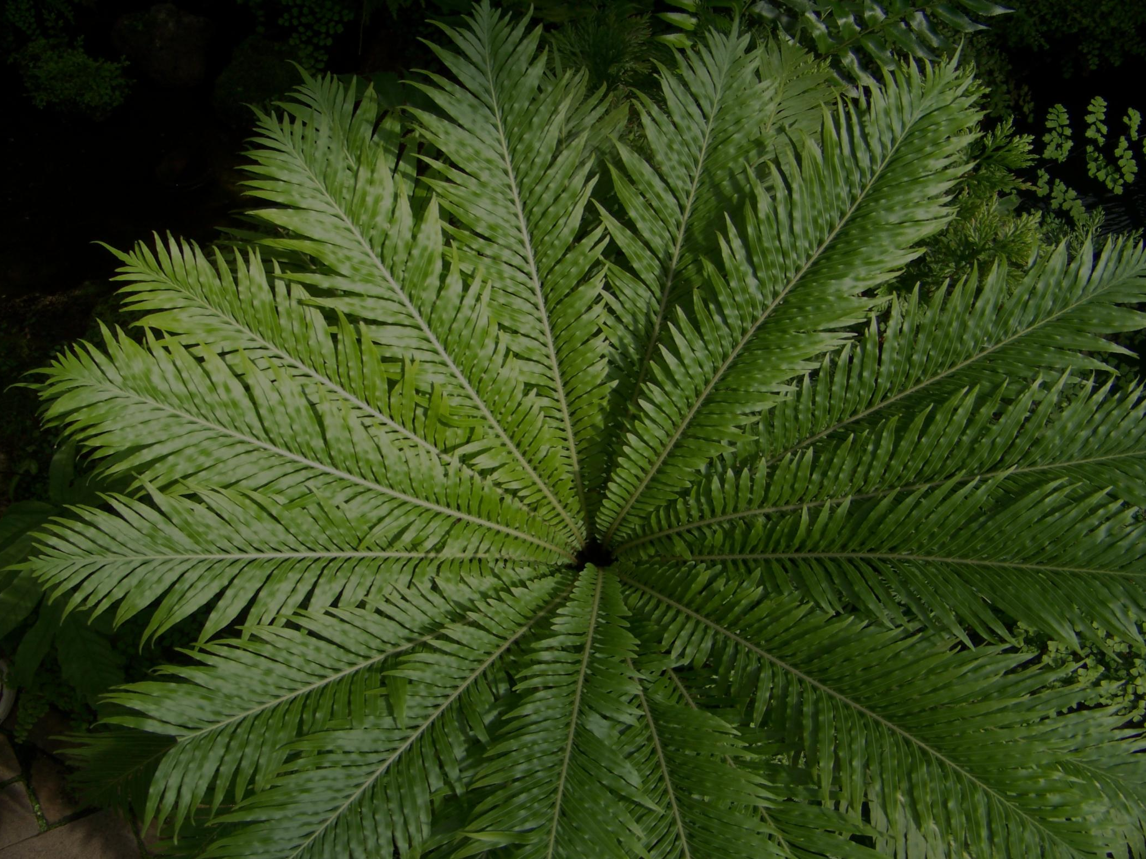
SearchMOR:
An Integrated Botanical and Herbarium Collections Database
Bethany H. Brown, Edward A. Hedborn, Jeanette McBride
Andrew L. Hipp and Kunso Kim
The Morton Arboretum

Slide 2
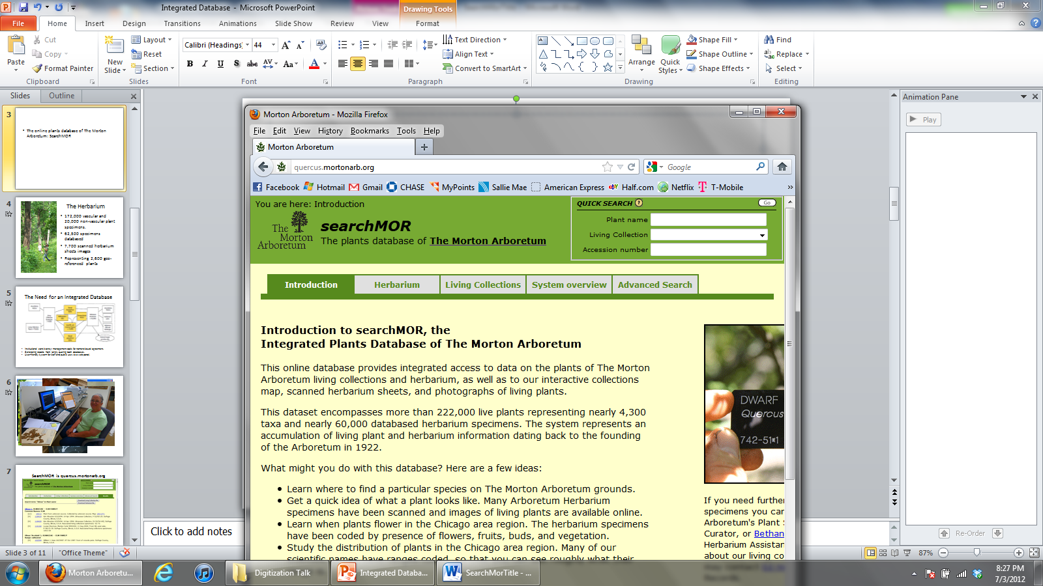
The online plants database of
The Morton Arboretum: SearchMOR (http://quercus.mortonarb.org/)
The need for an integrated database for two collections
Benefits of SearchMOR
The current status of usership

Slide 3

The Living Collection
One of the most comprehensive woody collections in North America
Consisting of 220,000 plants
Representing 4,300 taxa
From collections made in over 40 countries in the northern temperate zone worldwide
Edward A. Hedborn
Plant Collections Manager

Slide 4
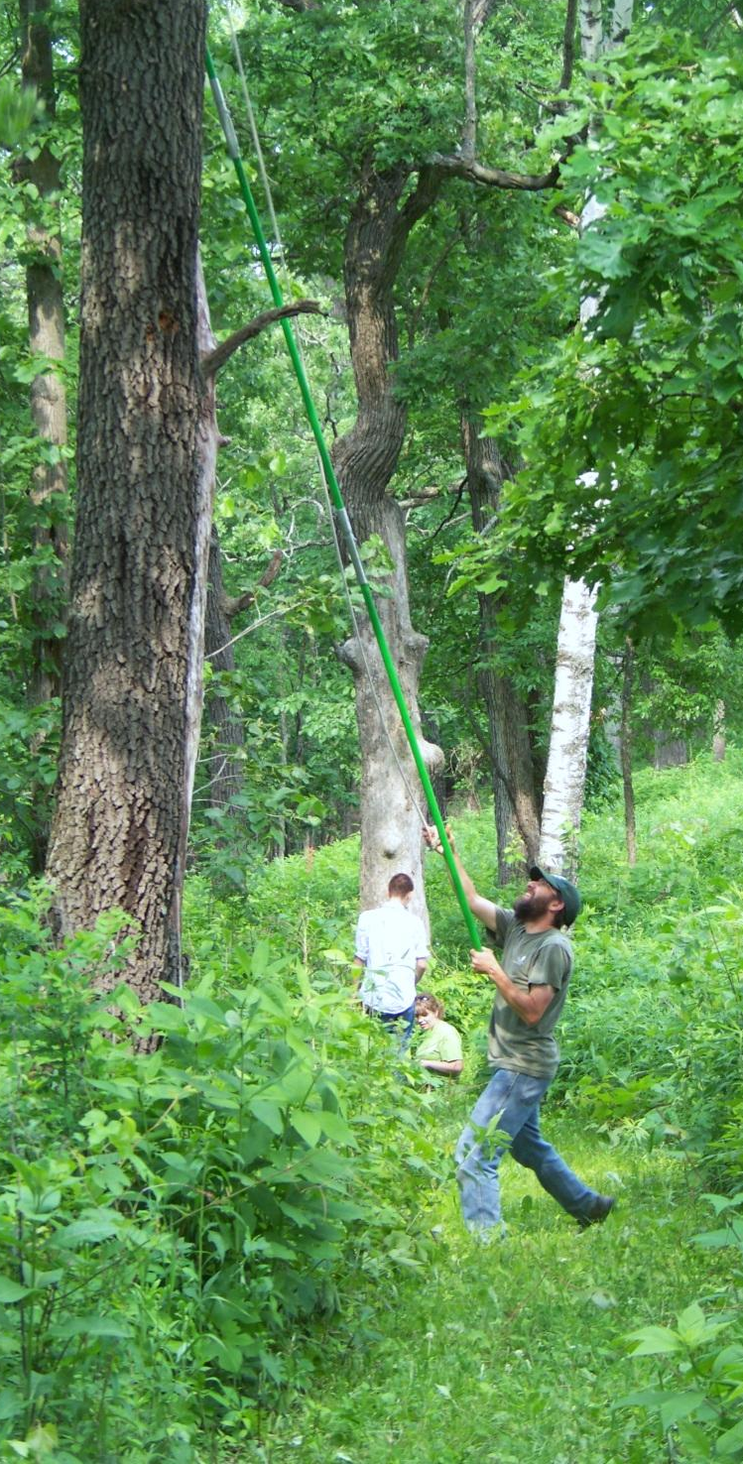
The Herbarium
172,000 vascular and 20,000 non-vascular plant specimens
62,500 specimens databased
7,700 scanned herbarium sheets images
Andrew L. Hipp
Herbarium Curator &
Plant Systematist

Slide 5
The Need for an Integrated Database
Many specimens in the herbarium have been collected from the Living Collection for taxonomic and identification purposes.
Institutional consistency: management tools for nomenclatural agreement
Generating reports by querying both databases
User-friendly system for staff and public use via a web portal

Slide 6
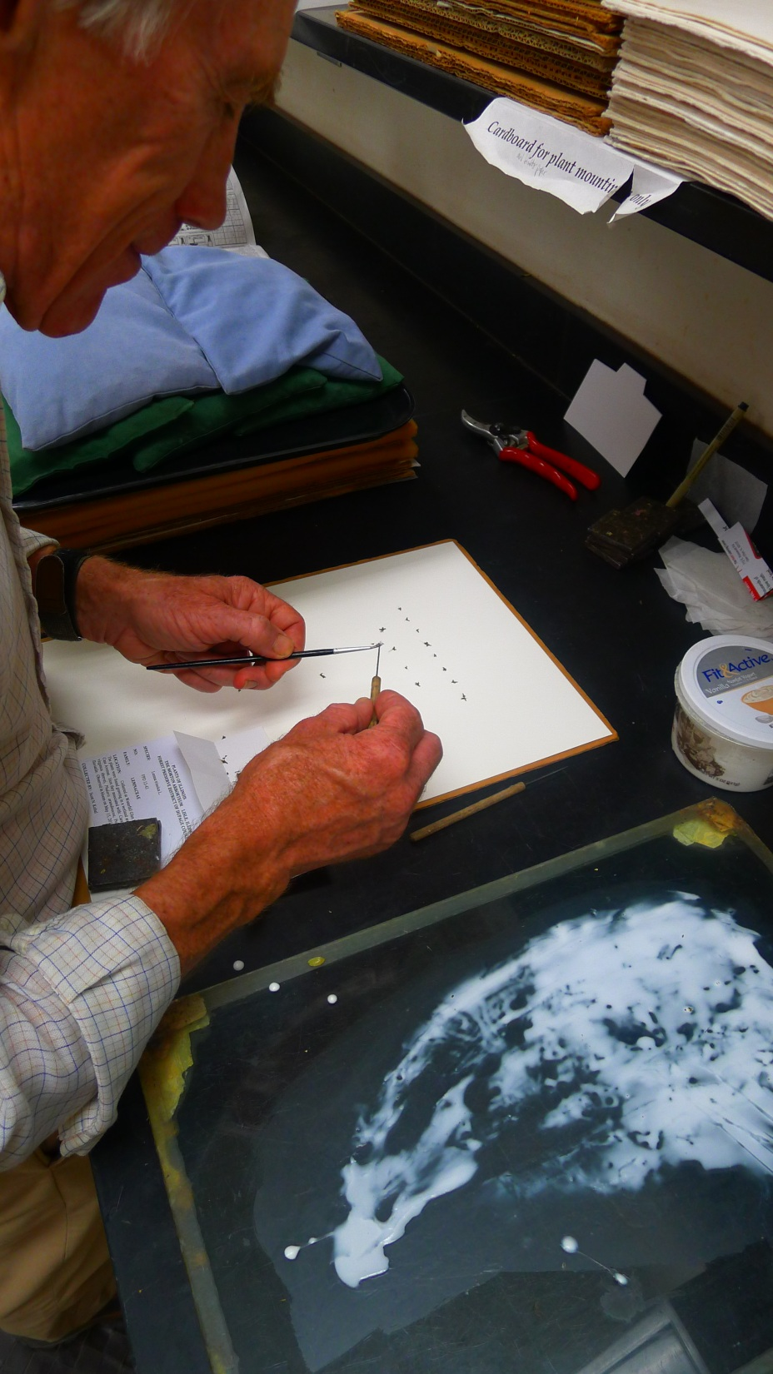
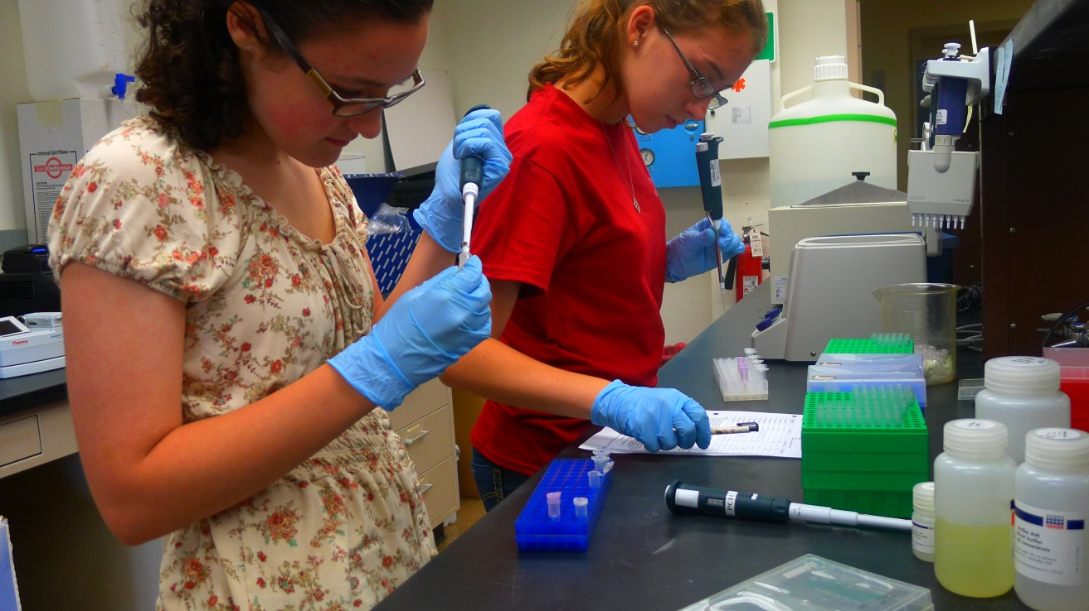
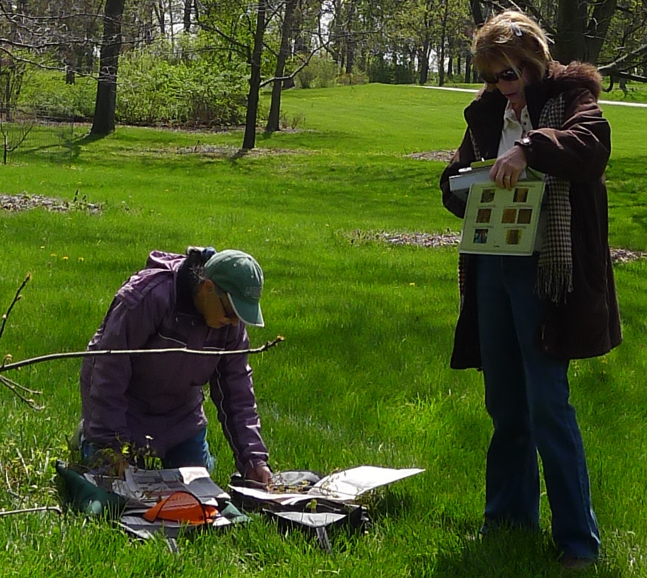
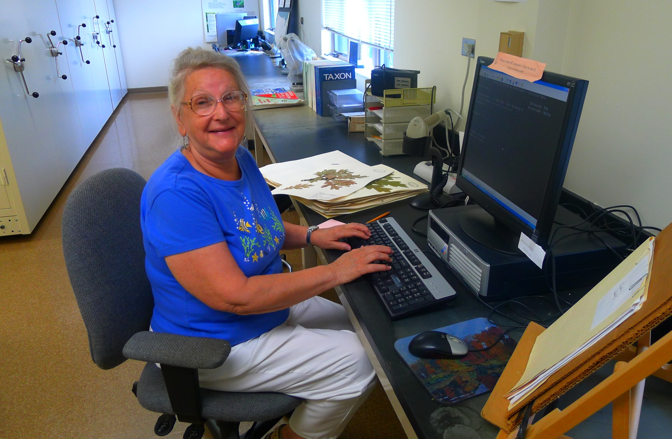
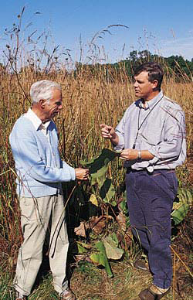
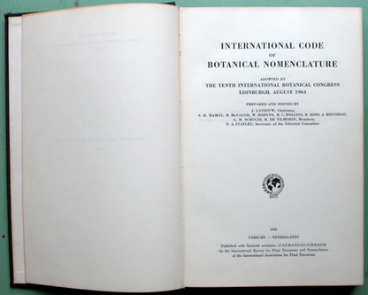

Slide 7
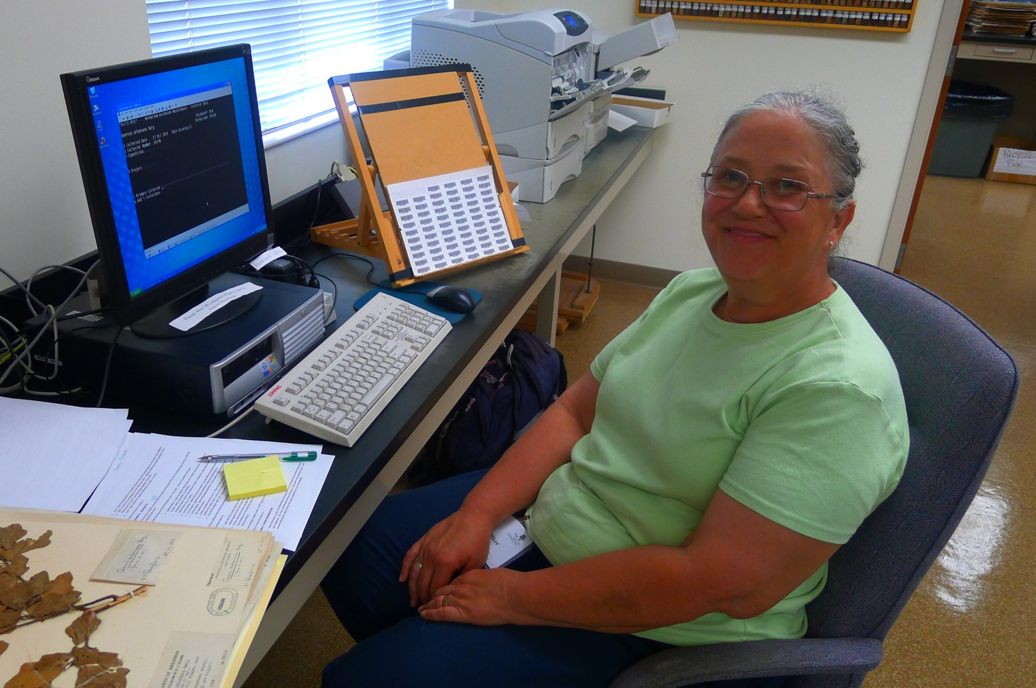
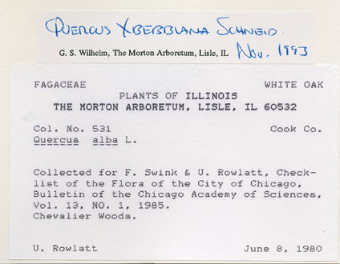
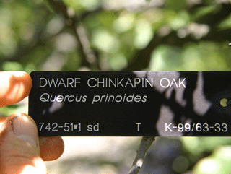

Slide 8
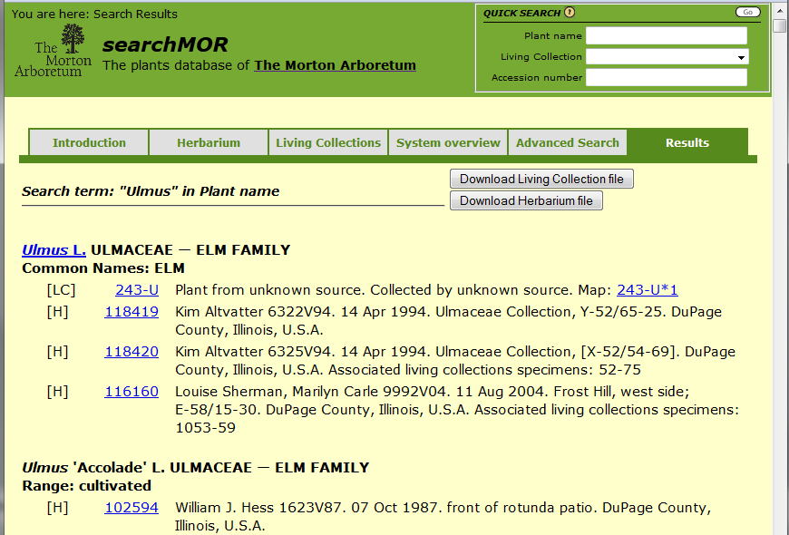
SearchMOR is quercus.mortonarb.org

Slide 9
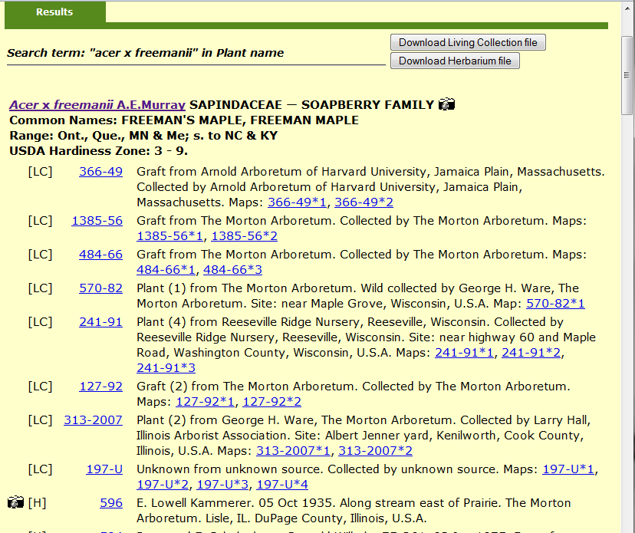
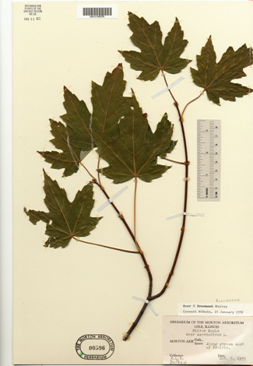
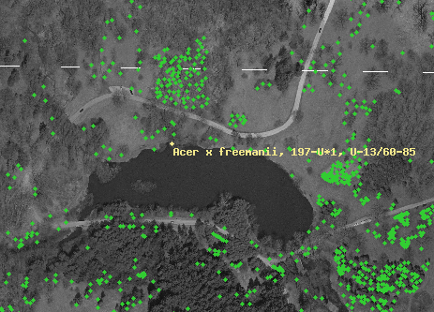
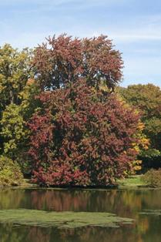

Slide 10
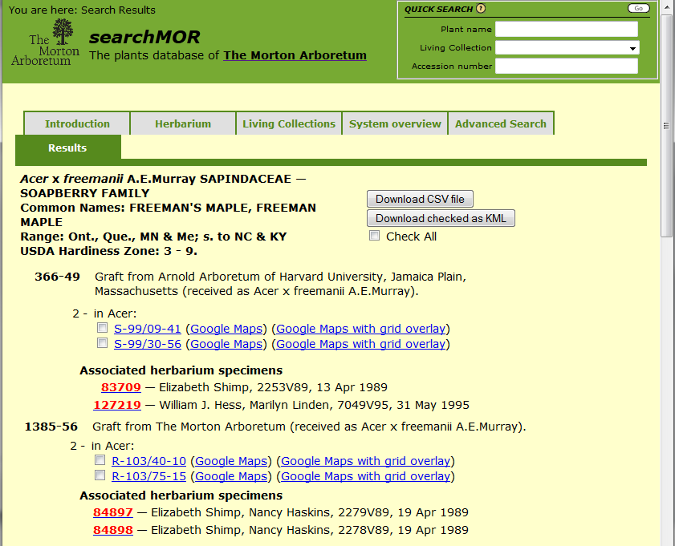

Slide 11
Database User Statistics

Slide 12
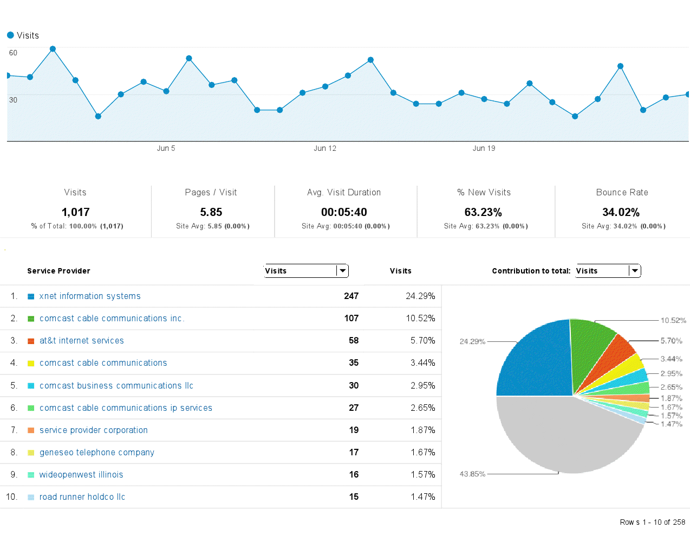

Slide 13
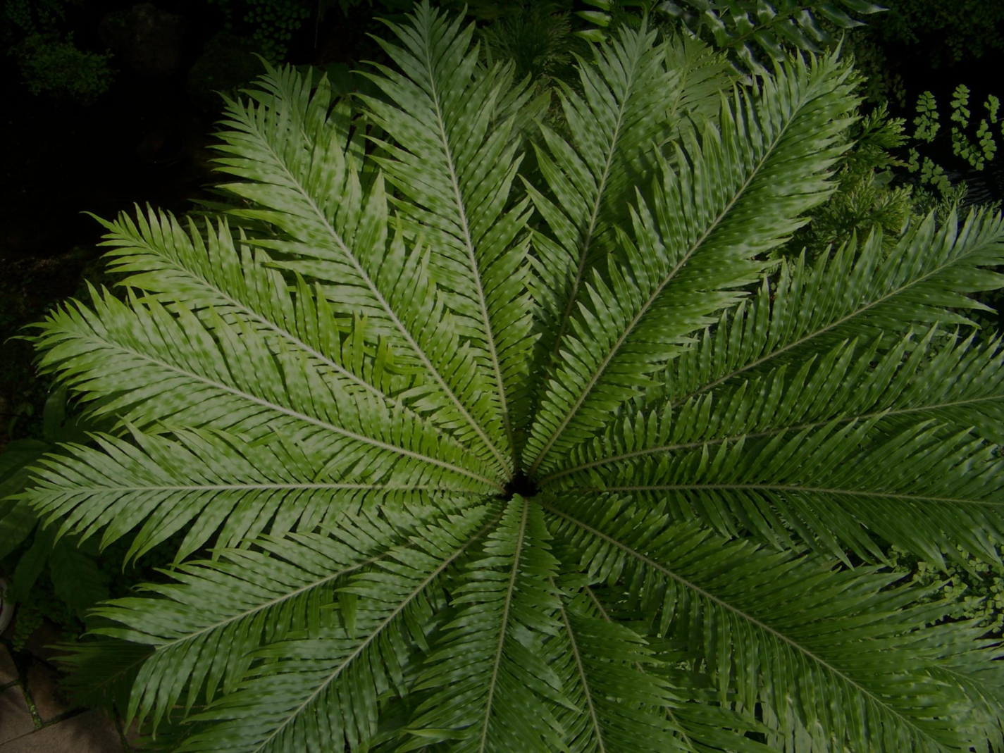

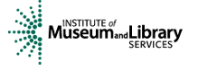
THANK YOU!
Bakken Software Services

